Slide 1

Forest Fire Detection Using Deep Neural Network Models
Course Code: BCSE497J Project-I
Guide: Dr. ANIL KUMAR K
KARAN SAOJI 21BCE2266
RUDRAKSH AGARWAL 21BCT0005
VEDANT BHALERAO 21BCI0193

Slide 2

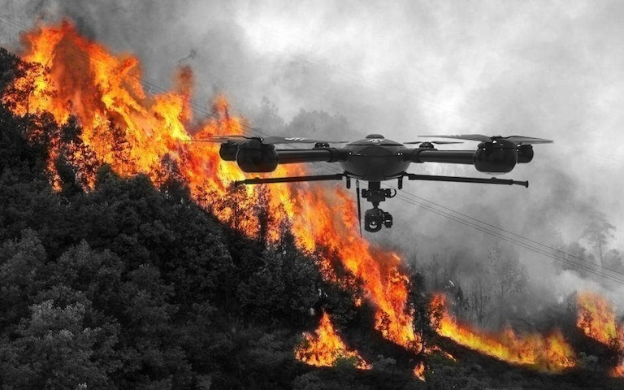
OBJECTIVE
The primary aim is to identify the most effective object detection model for accurately and efficiently detecting forest fires.
UAV Integration: This vision model can be deployed on UAVs to detect forest fires in real time, notifying authorities promptly to prevent fires from spreading and minimising potential damage.
Forest Surveillance Camera Utilisation: Surveillance cameras positioned within and around forest areas can employ this model to detect fire indicators and send alerts, enabling rapid response to potential catastrophes.

Slide 3

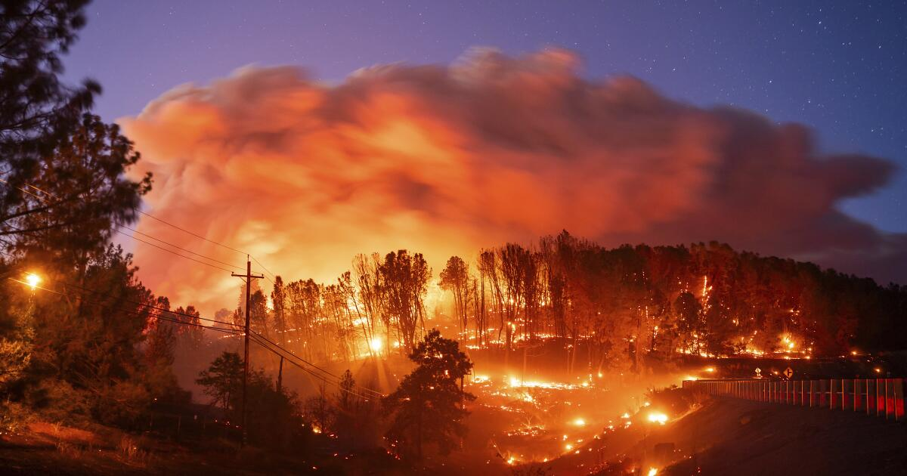
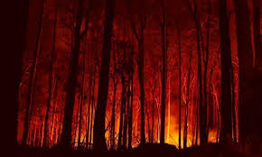
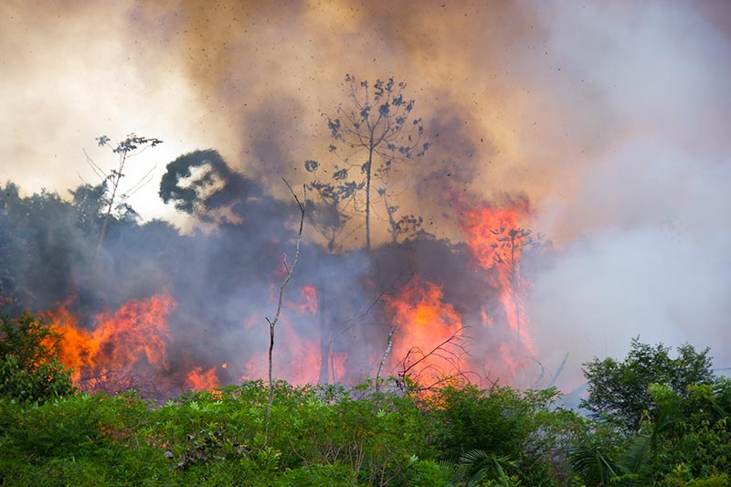
Motivation
Notable forest fire incidents
Incident | Location | Year
California Wildfires | California, USA | 2020
Australian Bushfires | Australia | 2019-2020
Amazon Rainforest Fires | Amazon Rainforest | 2019

Slide 4

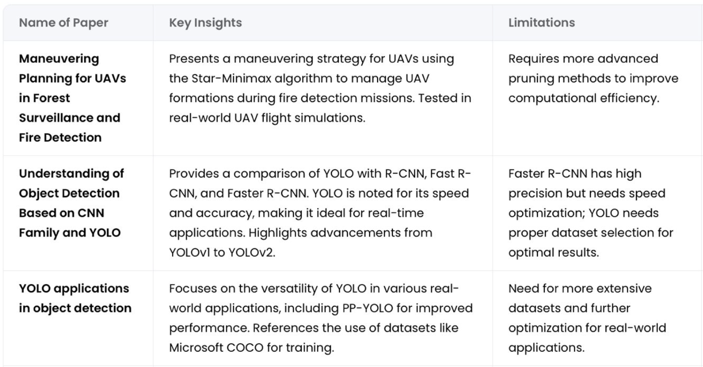
Literature Survey

Slide 5
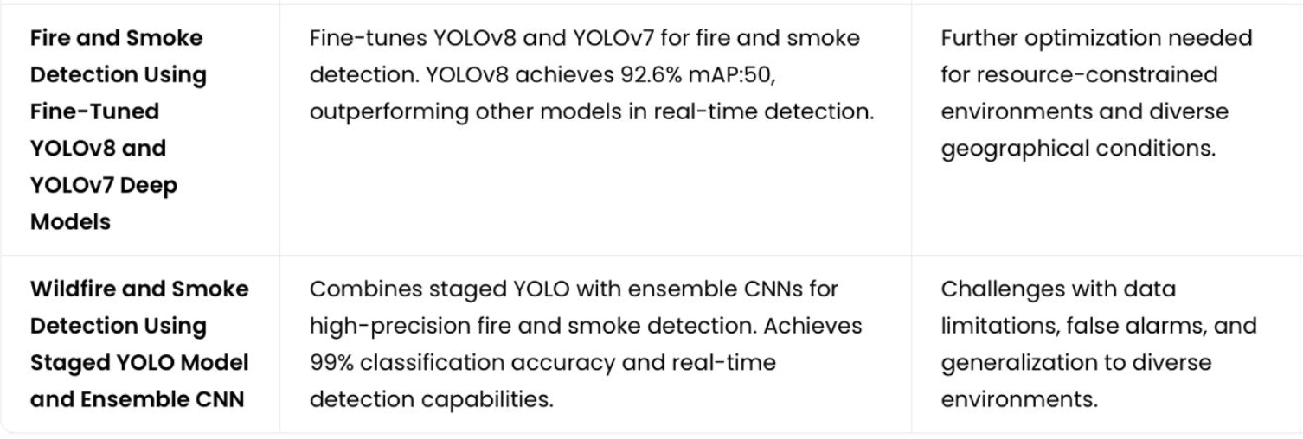
Literature Survey

Slide 6

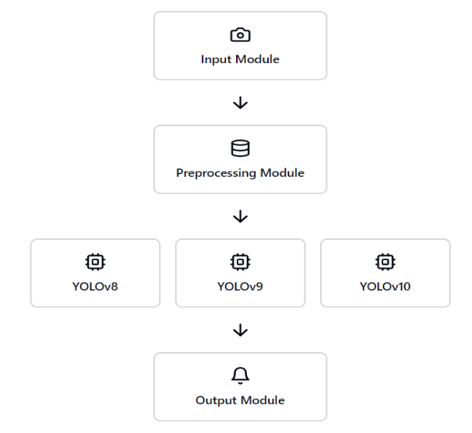
Problem Formulation

Slide 7
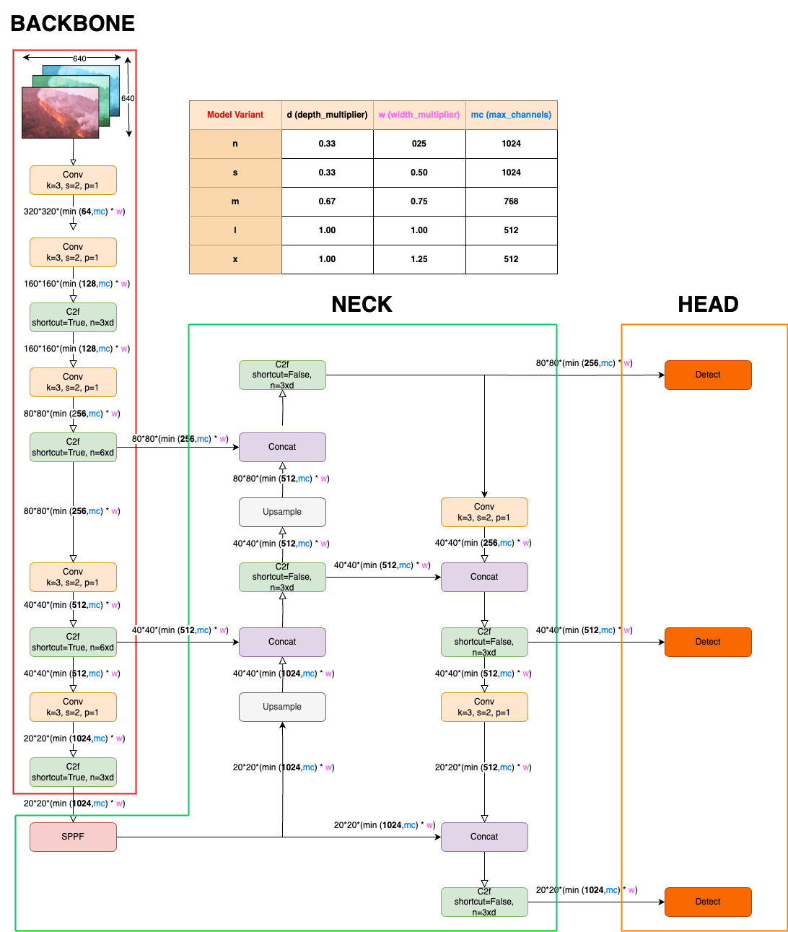

Architecture
YOLO v8

Slide 8
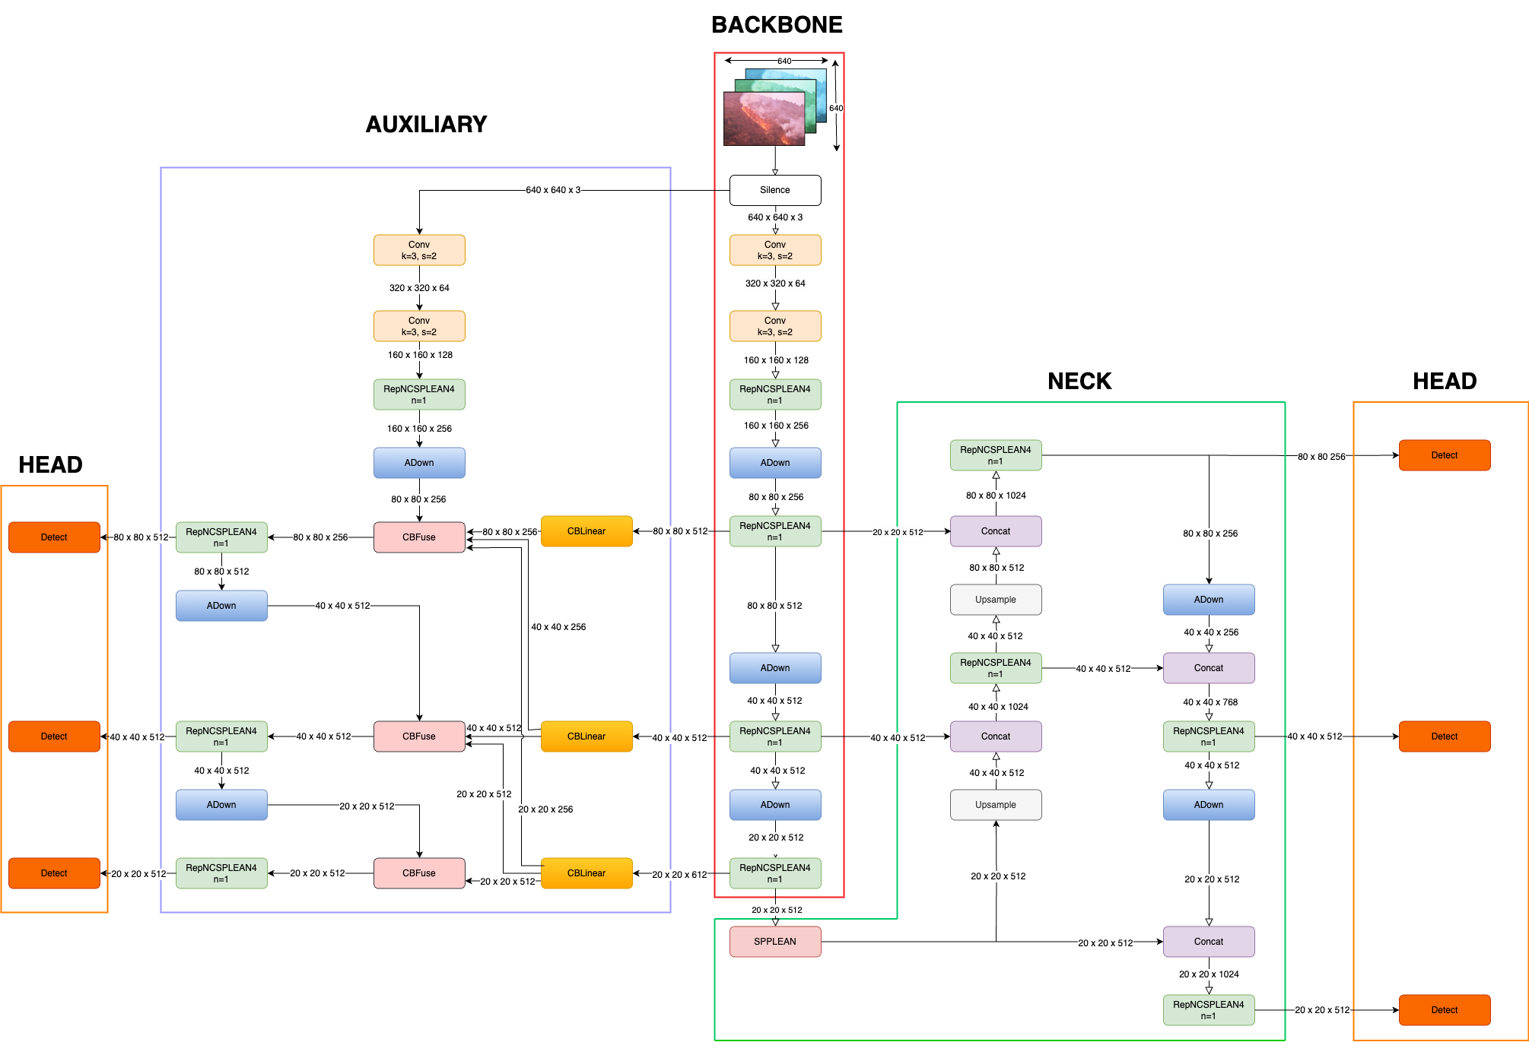
Architecture
YOLO v9

Slide 9
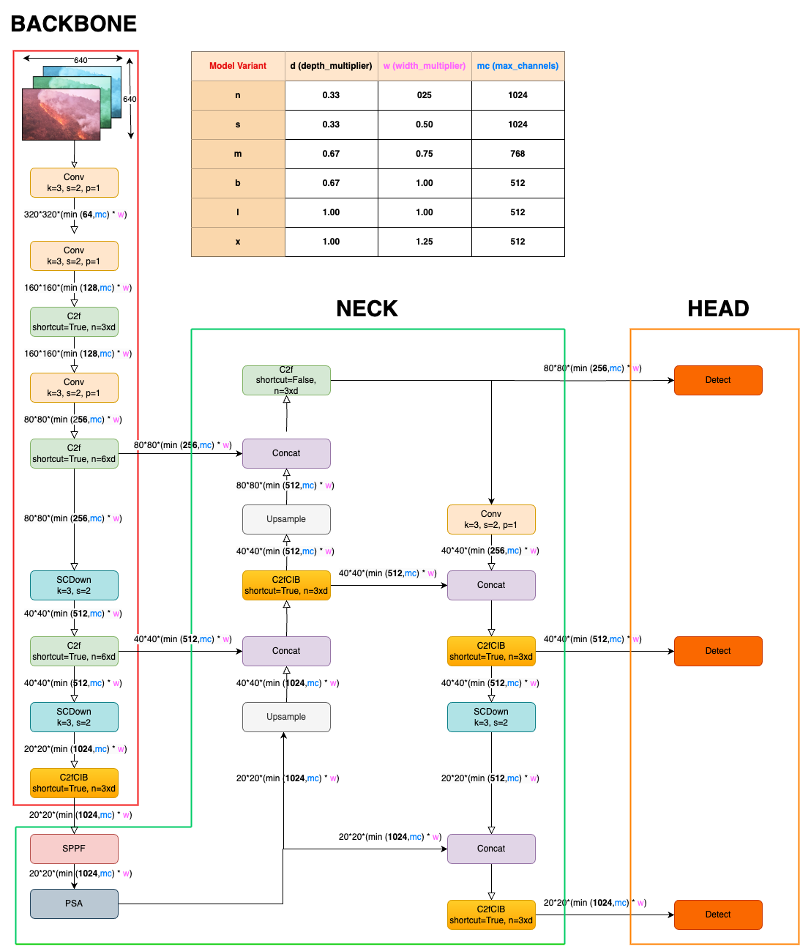
Architecture
YOLO v10

Slide 10

Result
Ref. No | Models | Efficiency (%)
 |  | mAP:50 | Pre | Rec
1 | 10-m AdamW | 82.8 | 0.82888 | 0.73157
2 | 10-m SGD | 86.1 | 0.83437 | 0.80389
3 | 10-n AdamW | 82.6 | 0.8291 | 0.7427
4 | 10-n SGD | 82.3 | 0.80077 | 0.77705
5 | 10-s AdamW | 83.8 | 0.83621 | 0.74409
6 | 10-s SGD | 86.4 | 0.88114 | 0.78442
7 | 8-m AdamW | 84.5 | 0.85475 | 0.73662
8 | 8-m SGD | 84.8 | 0.85144 | 0.75382
9 | 8-n Adam W. | 83.1 | 0.84408 | 0.73034
10 | 8-n SGD | 83.1 | 0.8366 | 0.73853
11 | 8-s AdamW | 84.0 | 0.84395 | 0.73712
12 | 8-s SGD | 85.0 | 0.82747 | 0.74043
13 | 9-c AdamW | 83.5 | 0.84389 | 0.73157
14 | 9-c SGD | 85.6 | 0.85706 | 0.74687
15 | 9-m AdamW | 83.6 | 0.8533 | 0.72879
16 | 9-m SGD | 84.4 | 0.83107 | 0.76078
17 | 9-s AdamW | 82.7 | 0.85443 | 0.73157

Slide 11

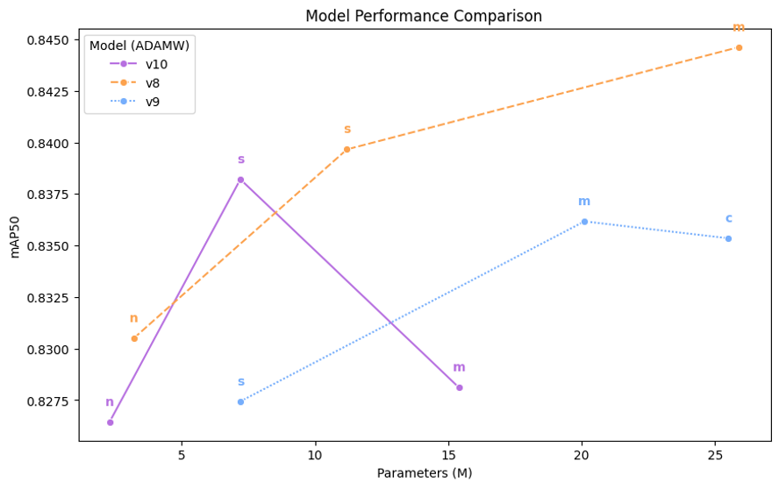
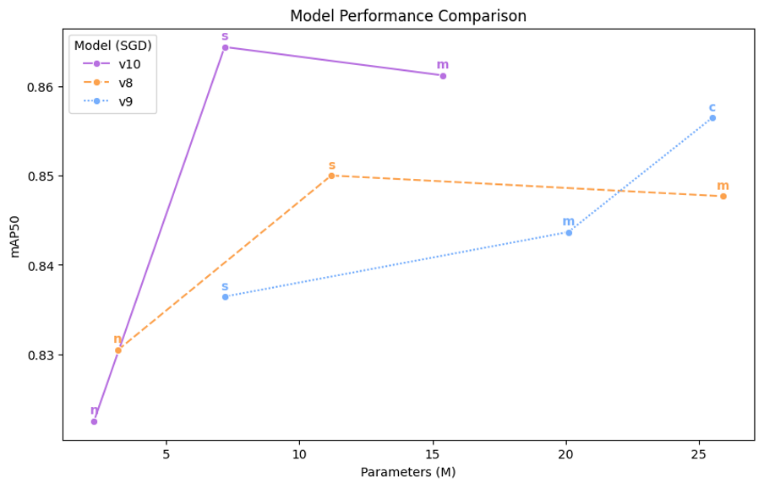
Analysis
mAP vs Parameters
SGD
ADAMW

Slide 12
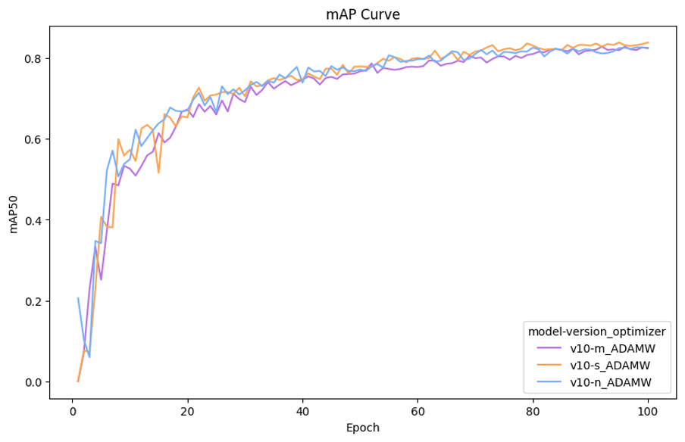
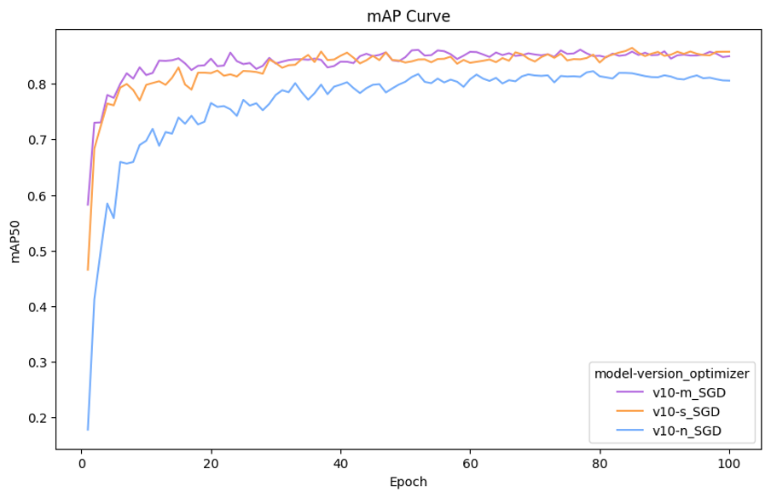
Analysis
maP YOLO v10
SGD
ADAMW

Slide 13
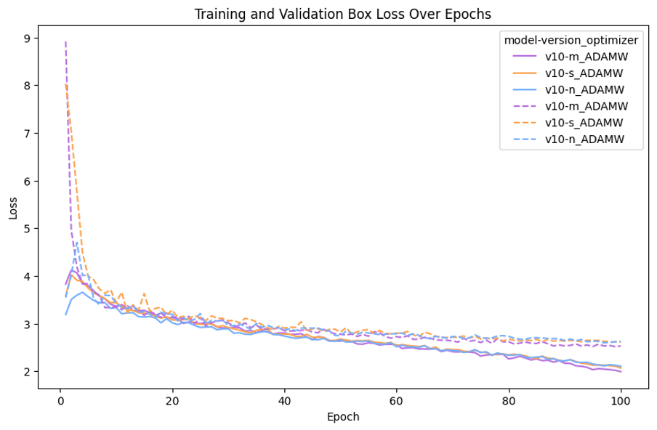
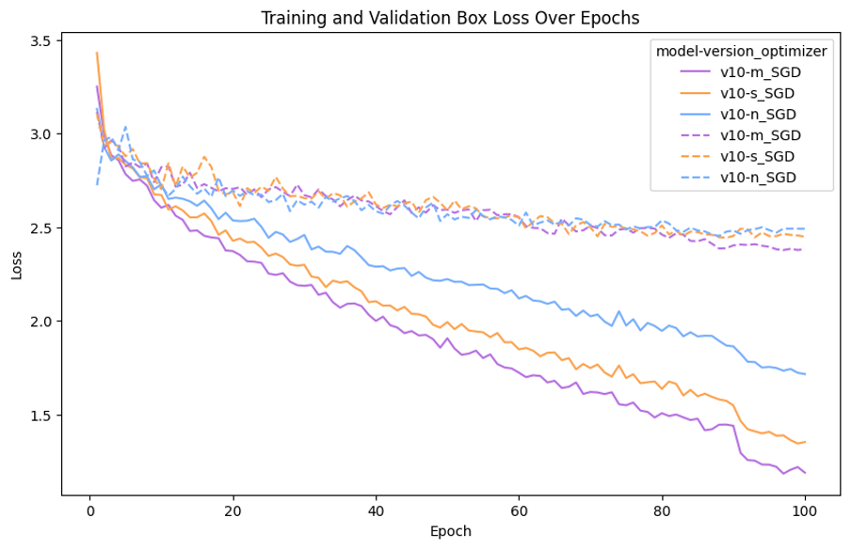
Analysis
Loss YOLO v10
SGD
ADAMW

Slide 14
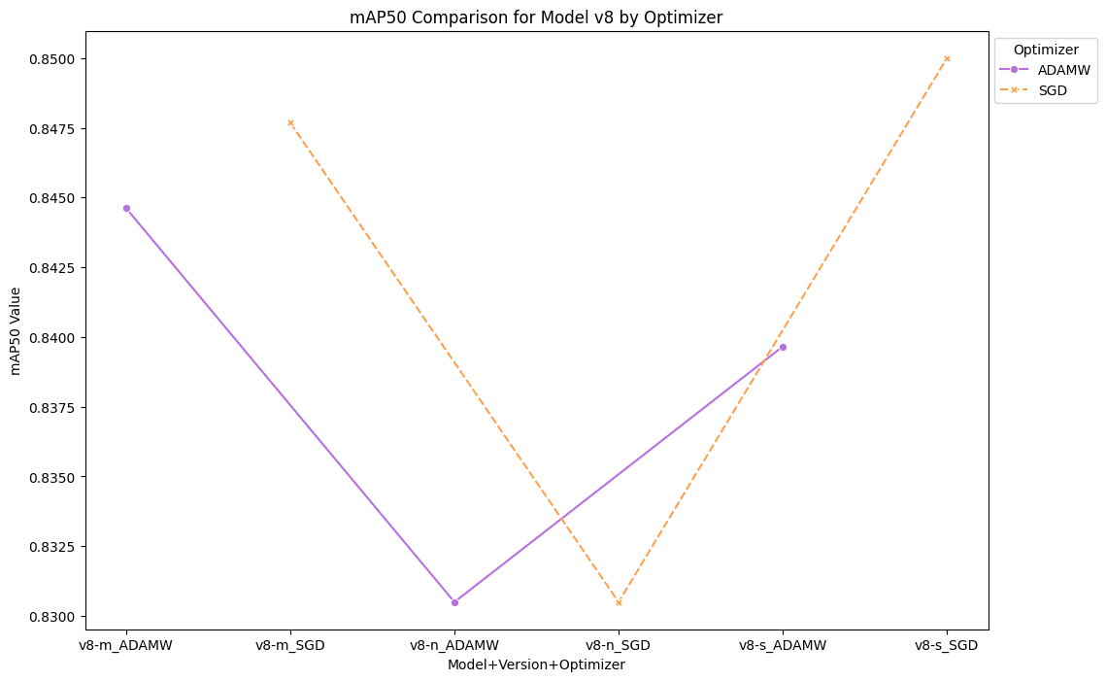
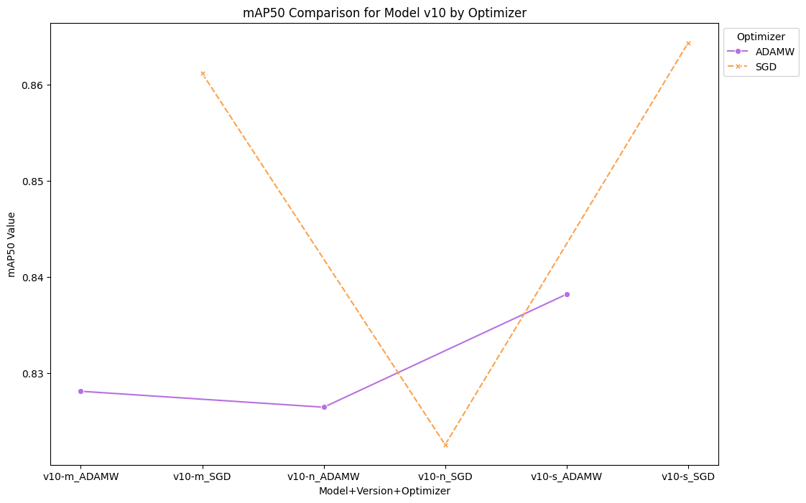
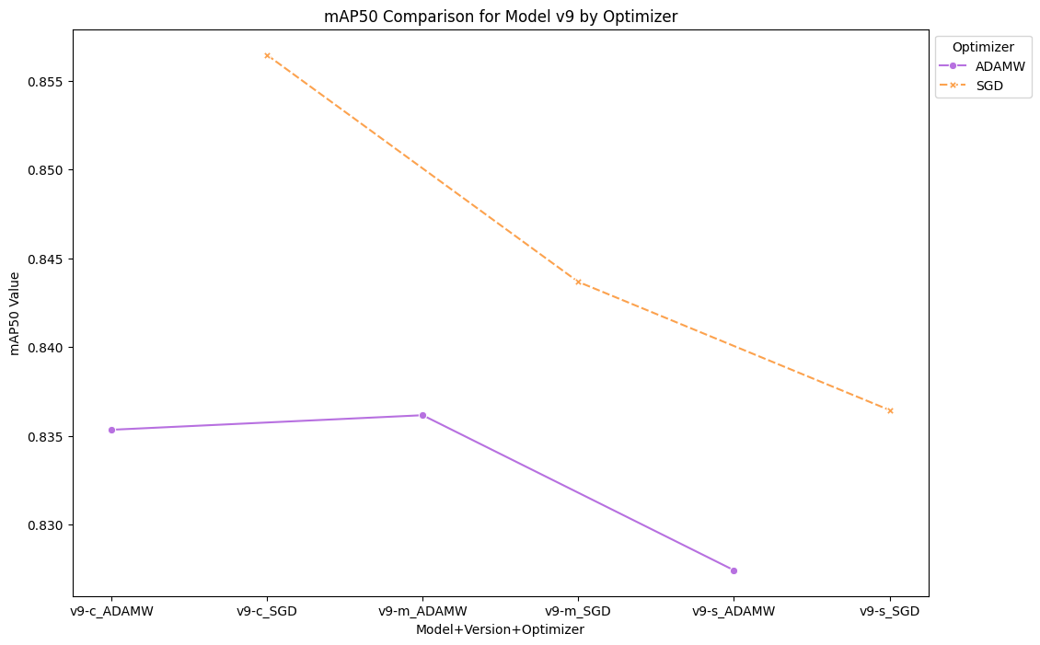
Analysis
mAP (modelWise)
YOLO v8
YOLO v10
YOLO v9

Slide 15
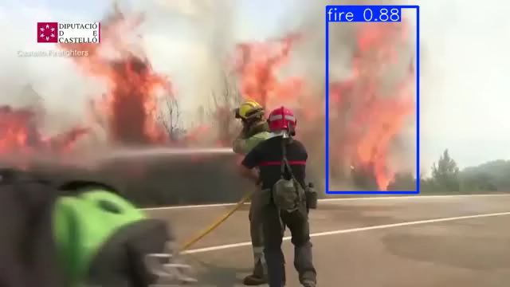
Conclusion

Slide 16

References
L. Zhang, Z. Zhao, L. Mu, Z. Liu, Y. Fu, and Y. Zhang, “Maneuvering Planning for UAVs in Forest Surveillance and Fire Detection Missions with Kinematic Uncertainties," in Proc. 2022 5th Int. Symp. on Autonomous Systems (ISAS), Hangzhou, China, 2022, pp. 1-8, doi: 10.1109/ISAS55863.2022.9757293.
Y. Du, "Object Detection Based on CNN and YOLO: A Comparison with R- CNN, Fast R-CNN, and Faster R-CNN," in Proc. J. Phys.: Conf. Ser., vol. 1004, 2018, Art. no. 012029, doi: 10.1088/1742-6596/1004/1/012029. M. Chetoui and M. A. Akhloufi, "Fire and Smoke Detection Using Fine- Tuned YOLOv8 and YOLOv7 Deep Models," Fire, vol. 7, no. 4, p. 135, 2024, doi: 10.3390 fire7040135.
C. Bahhar, A. Ksibi, M. Ayadi, M. M. Jamjoom, Z. Ullah, B. O. Soufiene, and H. Sakli, "Wildfire and Smoke Detection Using Staged YOLO Model and Ensemble CNN," Electronics, vol. 12, no. 1, p. 228, 2023, doi: 10.3390/electronics12010228.
R. Arora, M. Khosravi, S. Enayati, and H. Pishro-Nik, "Deployment of a UAV-Based Fire Detection System," in Proc. 2023 IEEE 97th Vehicular Technology Conference (VTC2023-Spring), Florence, Italy, 2023, pp. 1-6, doi: 10.1109/VTC2023-Spring57618.2023.10200883.

Slide 17
References
L. Zhang, Z. Zhao, L. Mu, Z. Liu, Y. Fu, and Y. Zhang, “Maneuvering Planning for UAVs in Forest Surveillance and Fire Detection Missions with Kinematic Uncertainties," in Proc. 2022 5th Int. Symp. on Autonomous Systems (ISAS), Hangzhou, China, 2022, pp. 1-8, doi: 10.1109/ISAS55863.2022.9757293.
Y. Du, "Object Detection Based on CNN and YOLO: A Comparison with R- CNN, Fast R-CNN, and Faster R-CNN," in Proc. J. Phys.: Conf. Ser., vol. 1004, 2018, Art. no. 012029, doi: 10.1088/1742-6596/1004/1/012029. M. Chetoui and M. A. Akhloufi, "Fire and Smoke Detection Using Fine- Tuned YOLOv8 and YOLOv7 Deep Models," Fire, vol. 7, no. 4, p. 135, 2024, doi: 10.3390/fire7040135.
C. Bahhar, A. Ksibi, M. Ayadi, M. M. Jamjoom, Z. Ullah, B. O. Soufiene, an H. Sakli, "Wildfire and Smoke Detection Using Staged YOLO Model an Ensemble CNN," Electronics, vol. 12, no. 1, p. 228, 2023, doi: 10.3390/electronics12010228.
R. Arora, M. Khosravi, S. Enayati, and H. Pishro-Nik, "Deployment of a UAV-Based Fire Detection System," in Proc. 2023 IEEE 97th Vehicular Technology Conference (VTC2023-Spring), Florence, Italy, 2023, pp. 1-6, doi: 10.1109/VTC2023-Spring57618.2023.10200883.

Slide 18


